Slide 1
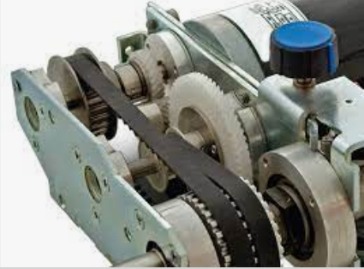
SYNCHRONOUS BELT DRIVES

Slide 2
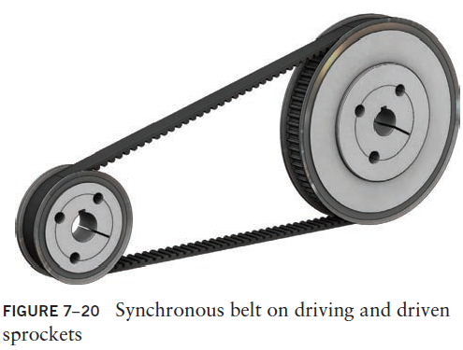
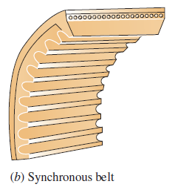
Synchronous Belt Drives
Synchronous belts are constructed with ribs or teeth across the underside of the belt

Slide 3
Synchronous Belt Drives
The teeth mate with corresponding grooves in the driving and driven pulleys, called sprockets, providing a positive drive without slippage.
Therefore, there is a fixed relationship between the speed of the driver and the speed of the driven sprocket.
Synchronous belts are often called timing belts and when properly designed will have an efficiency as high as 98%.
Synchronous belts can therefore be used for applications such as automatic machinery where a definite motion sequence or indexing is necessary.

Slide 4
Synchronous Belt Drives
Synchronous action is critical to the successful operation of such systems as printing, material handling, packaging, and assembly.
Synchronous belt drives are increasingly being considered for applications in which gear drives or chain drives had been used previously.
Because of the nature of synchronous belt mechanisms, they are also called ‘timing belt’ mechanisms. And they can be used in machinery where precision is very important. At power transmission of 3D printers, robotic mechanisms, synchronous belt drive mechanisms are generally used.

Slide 5
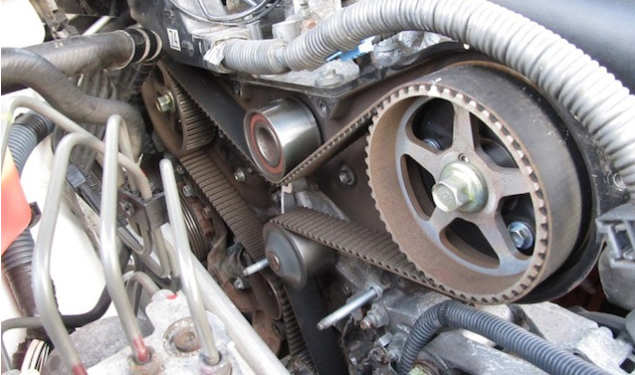
If you look at the front of the engine under the timing cover, you’ll find a tooth belt in some cases (although in most current vehicles, this belt is replaced by a chain).
It’s attached to the crankshaft and camshaft via several pulleys. Also called a gilmer drive belt many years ago.
The timing belt has two jobs.
It powers the engine’s camshaft
It keeps it exactly in sync with the crankshaft. This ensures that the valves open and close at the right time. That’s why it’s called a timing belt. It times the valvetrain.

Slide 6
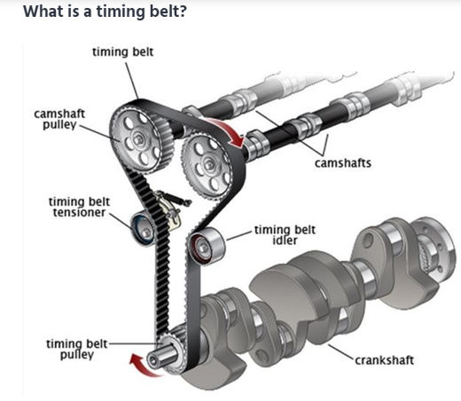
Most internal combustion engines utilize a similar design, with a crankshaft at the bottom, and a camshaft above it. Both shafts spin, with the crankshaft being connected to the pistons; rotating as the pistons move up and down. The camshaft uses a series of lobes to open and close the valves, which let air in and out of your engine.
Since it’s crucial that the valves open and close at the correct time, the crankshaft and camshaft are connected by a timing belt, or timing chain.
If this valve timing is not correct, the engine will perform poorly – or worse, may damage itself.
If your car is equipped with a timing belt, it is the single most important maintenance item on your vehicle.

Slide 7
Advantages of Synchronous Belt Drives
Synchronous belts provide a positive and trouble-free transmission of power and offer these advantages:
High capacity
Highly accurate registration
Low vibration
Low noise
No lubrication required
No stretching due to wear
Corrosion resistance
Abrasion resistance
Clean operation

Slide 8
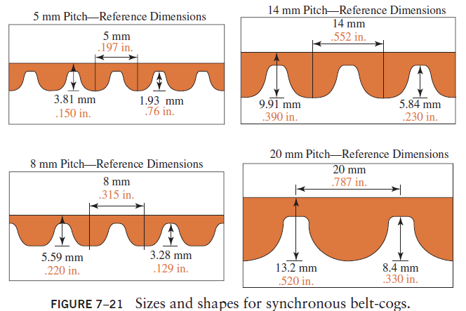
Sizes and Shapes for Synchronous Belts

Slide 9
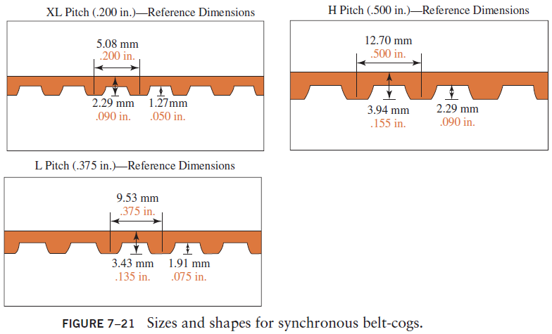
Sizes and Shapes for Synchronous Belts

Slide 10
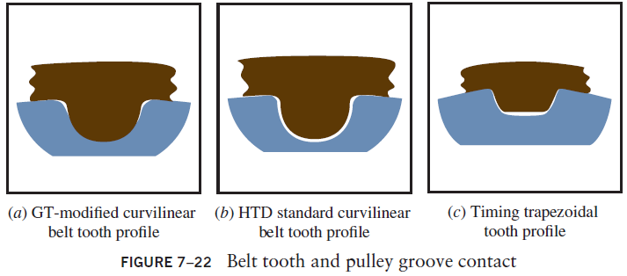

Belt Tooth Shape
(c) better timing and indexing
(b) high load-carrying capacity and is used in high-torque applications
(a) GT(Gates Tooth)-modified curvilinear tooth profile that offers improved indexing accuracy over the HTD

Slide 11
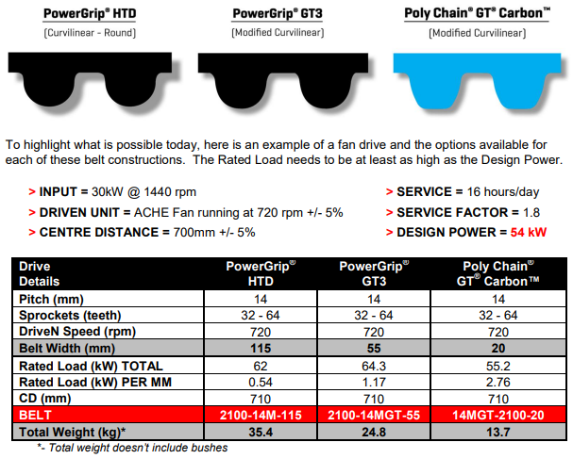

Slide 12
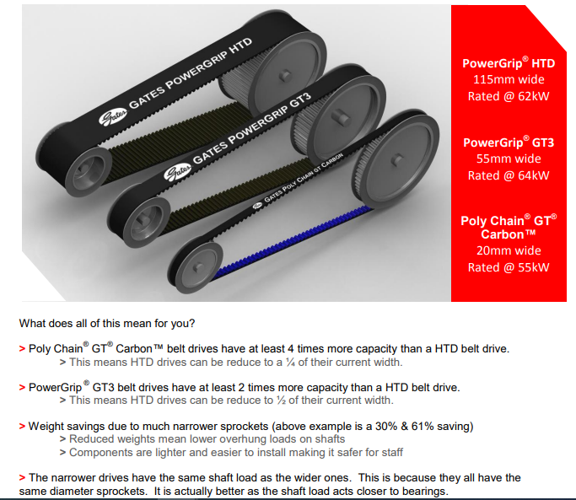

Slide 13
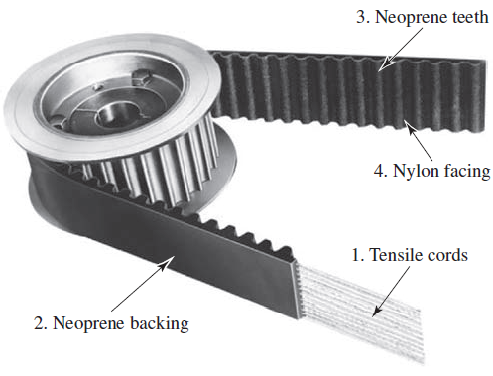

Synchronous Belt Construction

Slide 14
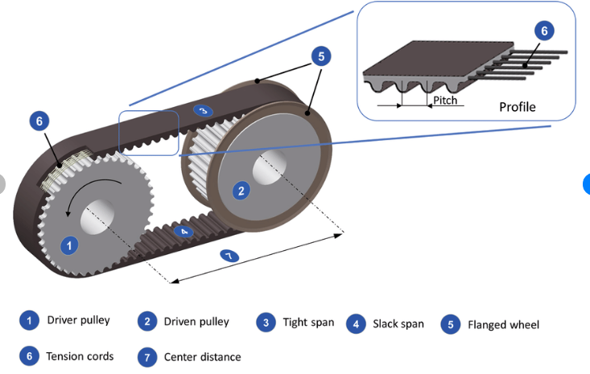

Slide 15
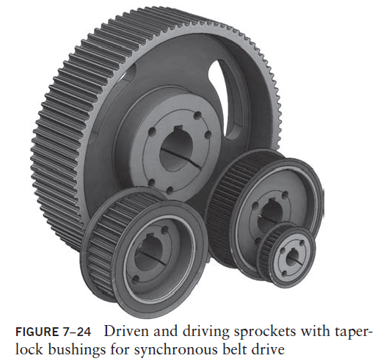
Sprockets and Bushings

Slide 16
Belt Dimensions
Various widths of belts are available for each given pitch to provide a wide range of power transmission capacity.
Belts are also available in various perimeter lengths. This allows a two-sprocket belt drive system to have a wide range of center distances
Belt Designation: 1760-8MGT-30
The first set of numbers (in mm) represents the belt perimeter, the second set represents the belt pitch with the style of the tooth profile, and the last number represents the belt width.

Slide 17
Sprocket Designations
Table 7–4 shows the available sprockets with a pitch of 8 mm.
The corresponding taper-lock bushing number is given for each sprocket and is based on the sprocket width.
Sprocket Designation: P72-8MGT-50
The first set of numbers (in mm) represents the number of teeth, the second set represents the belt pitch with the style of tooth profile, and the last number is the belt width.

Slide 18
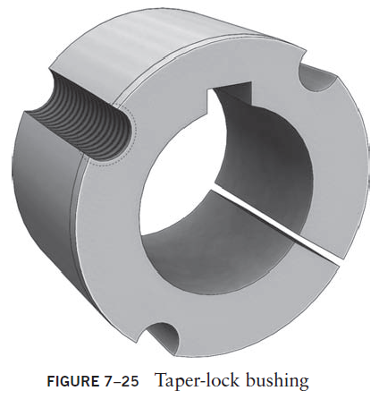
Taper-Lock Bushing
The taper-lock bushing minimum and maximum bore diameters will limit the size of the shaft for a specific sprocket.
The three half holes are aligned with the three half holes in the sprocket and are used to tighten the taper-lock bushing to the sprocket and remove the taper-lock bushing from the sprocket.

Slide 19
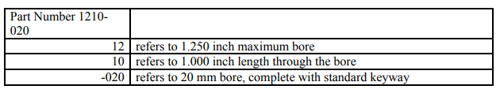
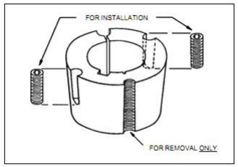
Taper-Lock Bushing
When installing or removing a Taper Lock bush, it is imperative that no lubrication be used between the taper.
The presence of lubricant on the tapered surfaces is not desirable, as the taper bushing relies on friction to operate effectively, and lubricants reduce friction.
We use industry standard Part Numbers to identify the specifications of each Taper Lock bush or Taper bush. For example:

Slide 20
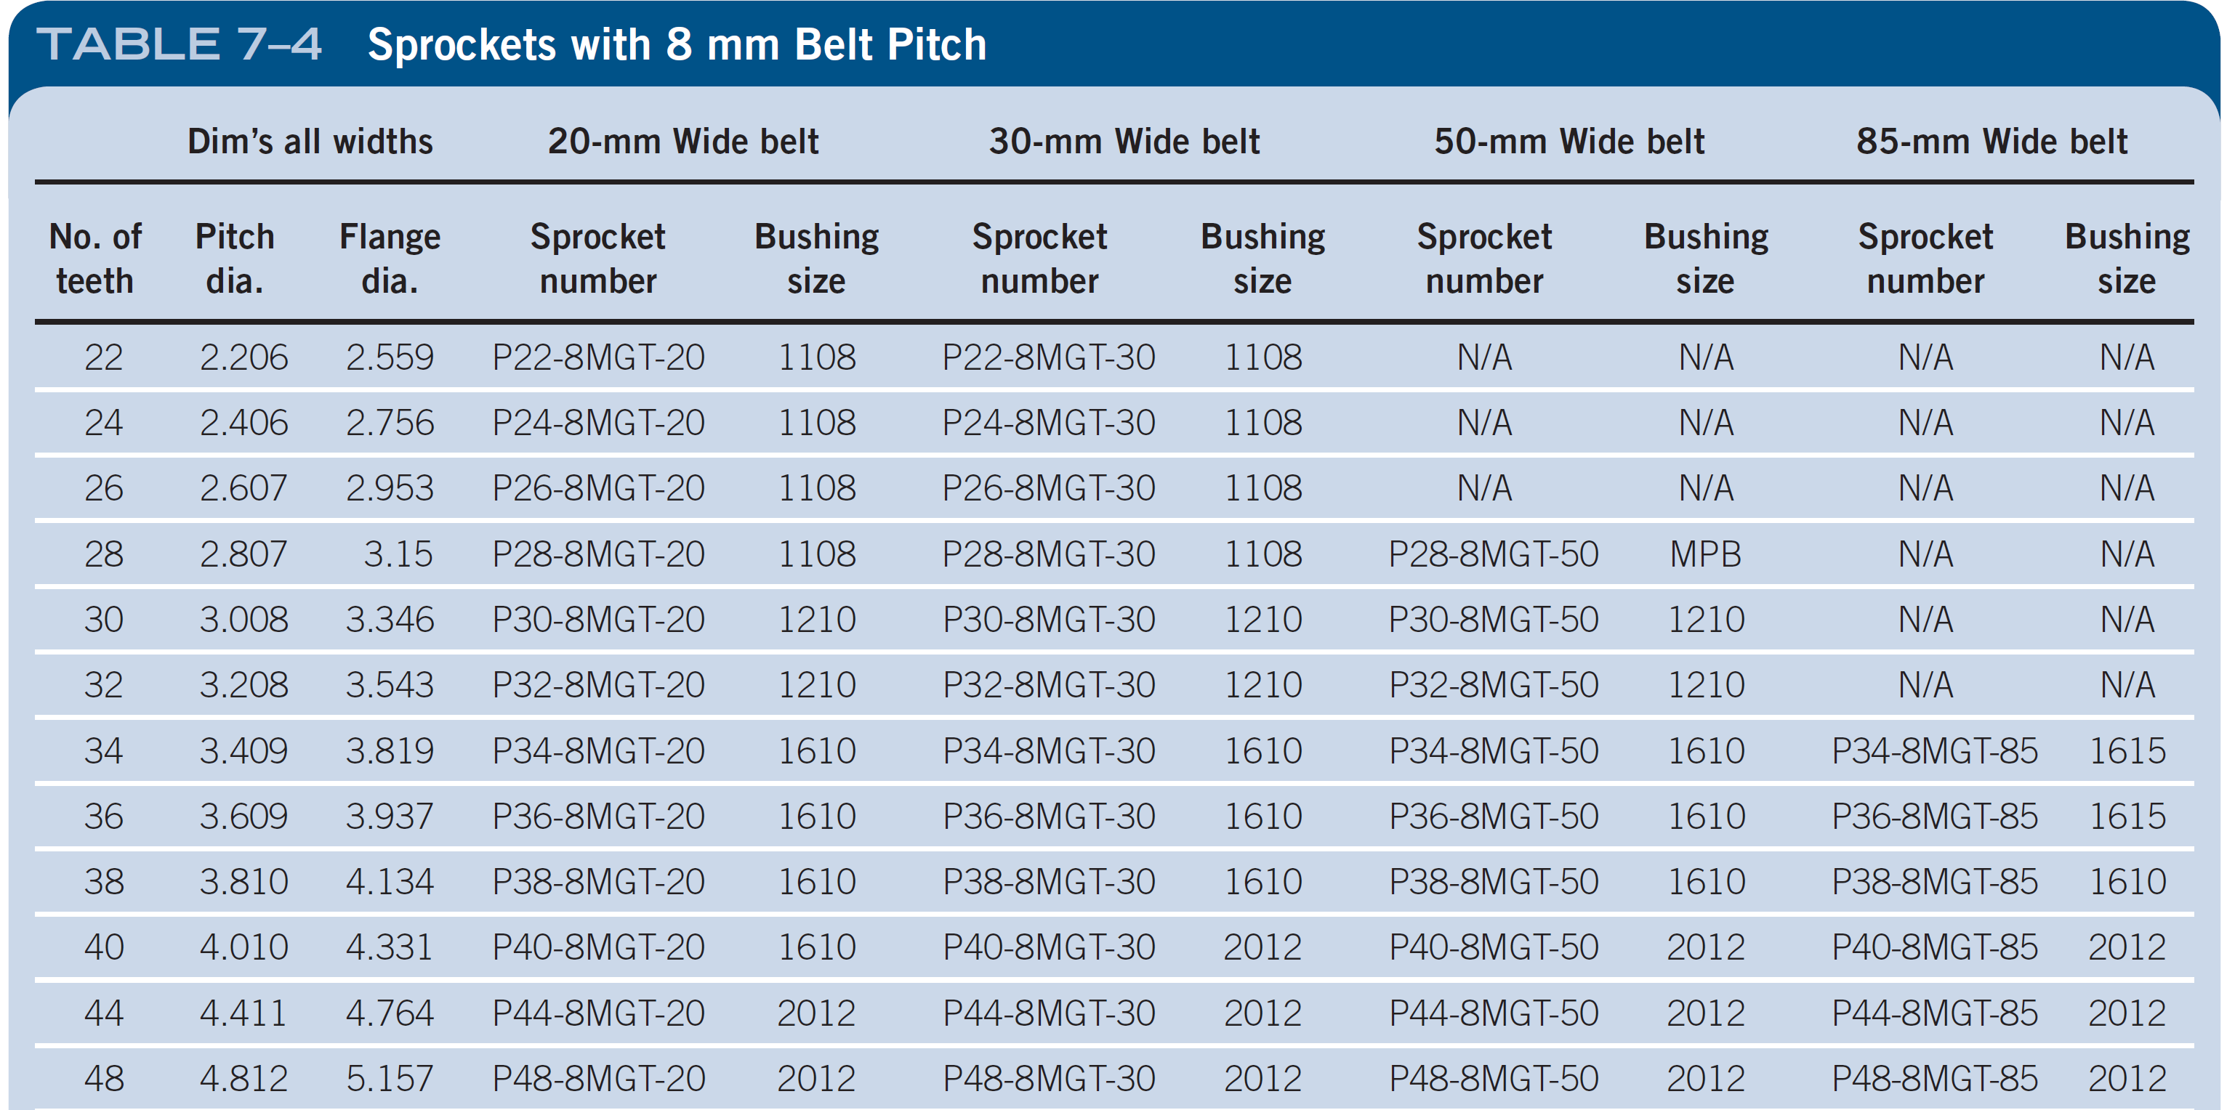
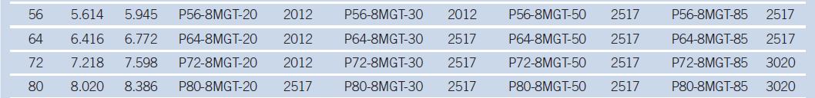
Sprockets with 8mm Belt Pitch

Slide 21
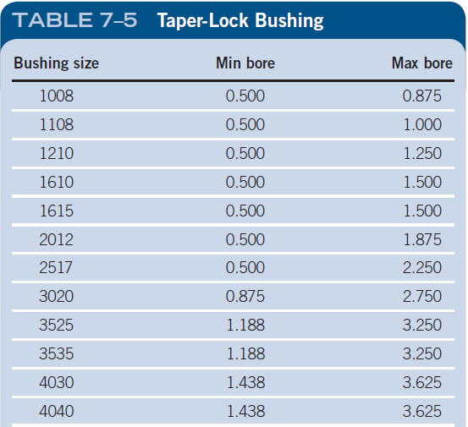
Taper-Lock Bushing

Slide 22
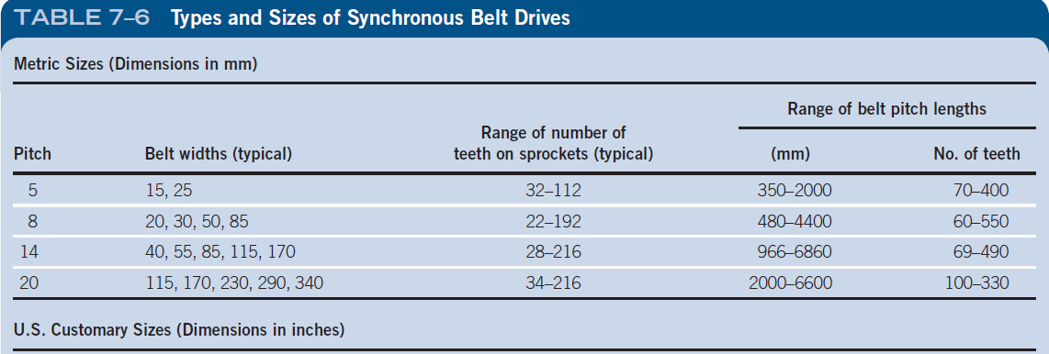
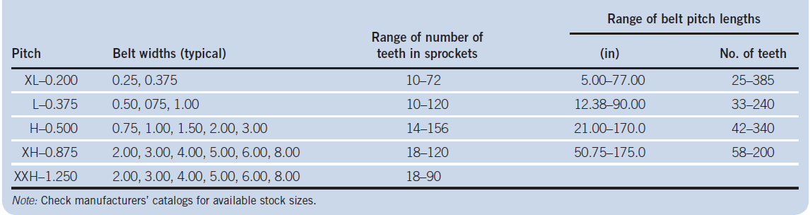

Slide 23
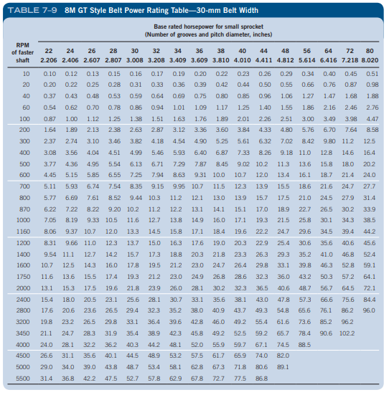

Slide 24
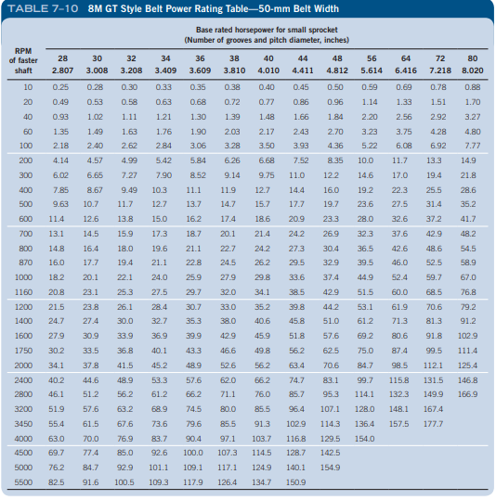

Slide 25
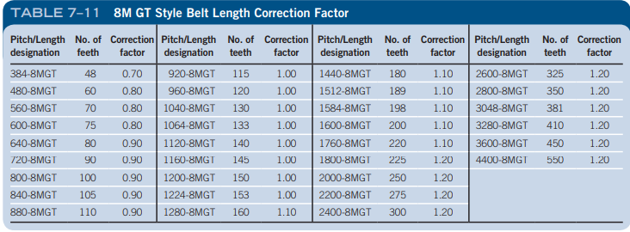

Slide 26
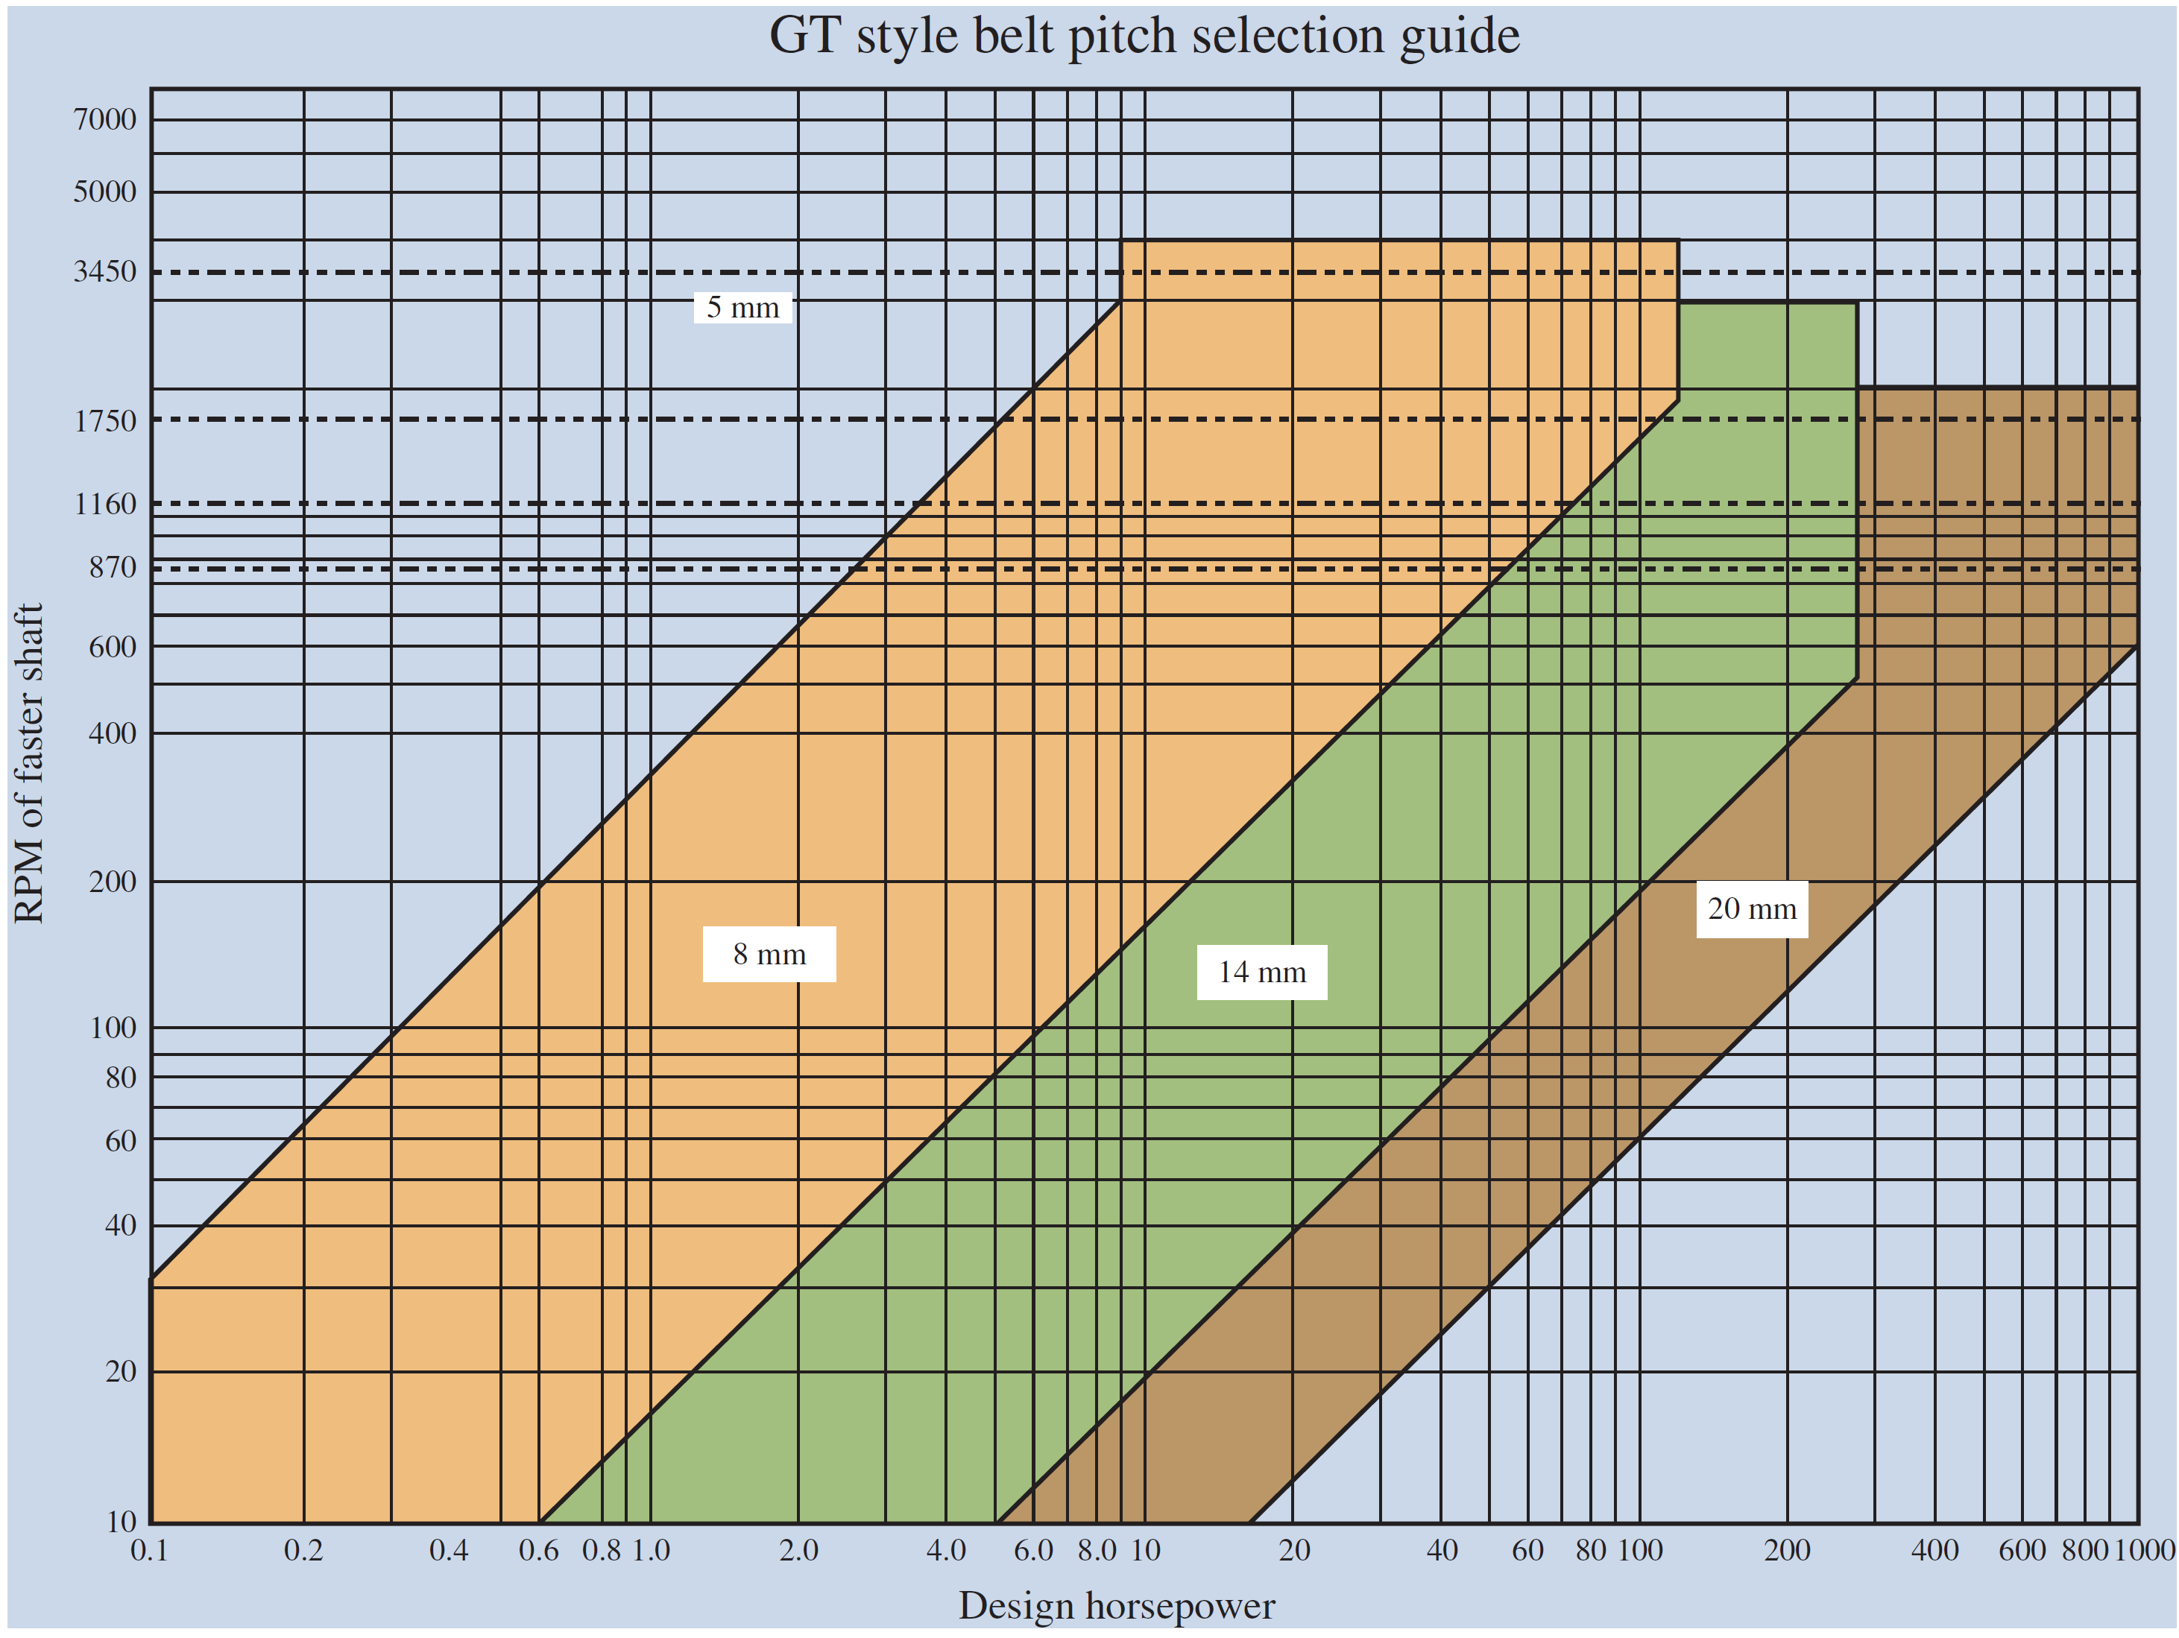
Sprocket Designations
Table 7–4 shows the available sprockets with a pitch of 8 mm.
The corresponding taper-lock bushing number is given for each sprocket and is based on the sprocket width.

Slide 27
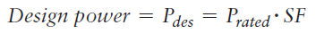
General Selection Procedure for Synchronous Belt Drives
Specify the speed of the driving sprocket (typically a motor or engine) and the desired speed of the driven sprocket.
Specify the rated power for the driving motor or engine. The rated power of the motor or engine is based on the calculated power of the driven machine.
Determine a service factor (SF) using Table 7–8.
Calculate the design power by multiplying the driver rated power by the service factor.

Slide 28
General Selection Procedure for Synchronous Belt Drives
Determine the required pitch of the belt using the belt pitch selection guide Figure (7-27). The belt pitch is based on the design power and the angular velocity of the faster (smaller) sprocket.
Calculate the velocity ratio VR between the driver and driven sprockets.
Select the candidate combinations using Table 7–7 of the number of teeth in the driver sprocket to that in the driven sprocket that will produce the calculated velocity ratio, VR.

Slide 29
General Selection Procedure for Synchronous Belt Drives
Eliminate the sprocket combinations that will not work due to space limitations and shaft diameter requirements. Some of the larger sprockets may interfere with the machine or guarding and can be eliminated due to these space limitations.
Using the desired range of acceptable center distances, determine a standard belt length that will produce a suitable value. Table 7–7 shows that the center distance is determined by the belt length and sprocket velocity ratio.

Slide 30
General Selection Procedure for Synchronous Belt Drives
Selection of the width of the belt: An 8-mm pitch belt is available in four different widths: 20 mm, 30 mm, 50 mm, and 85 mm. The belt width selection Tables 7–9 and 7–10 are shown for the 30-mm and 50-mm wide belts.
You will notice for a given sprocket size as the speed increases, the power rating of the belt increases.
A larger sprocket will decrease the belt width required and yield a longer service life. The belt width should not exceed the sprocket diameter.

Slide 31
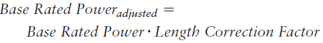
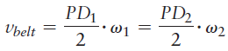
General Selection Procedure for Synchronous Belt Drives
Catalog data will show factors less than 1.0 for shorter belt lengths and greater than 1.0 for longer belt lengths.
Calculate the belt linear velocity. Belt speeds above 3500 fpm increase the noise level of the synchronous belt drive.

Slide 32
General Selection Procedure for Synchronous Belt Drives
Specify the final design details for the belt drive system. This includes all sprockets, type and bore size of taper-lock bushings, belt, and tensioner if required. Summarize the design, check compatibility with other components of the system, and prepare the purchasing documents.

Slide 33
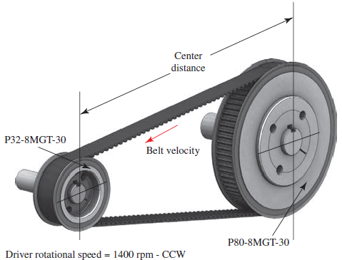
Example Problem
For the belt drive layout shown in Figure 7–28 perform the following calculations for the kinematics of the drive:

Slide 34
Example Problem
For the belt drive layout shown in Figure 7–28 perform the following calculations for the kinematics of the drive:
Specify the number of teeth and the pitch diameter of each sheave.
Calculate the velocity ratio of the belt drive and the angular velocity of the driven sheave.
Calculate the belt linear velocity.
Determine the center distance using a 1200- MGT-30 belt.

Slide 35
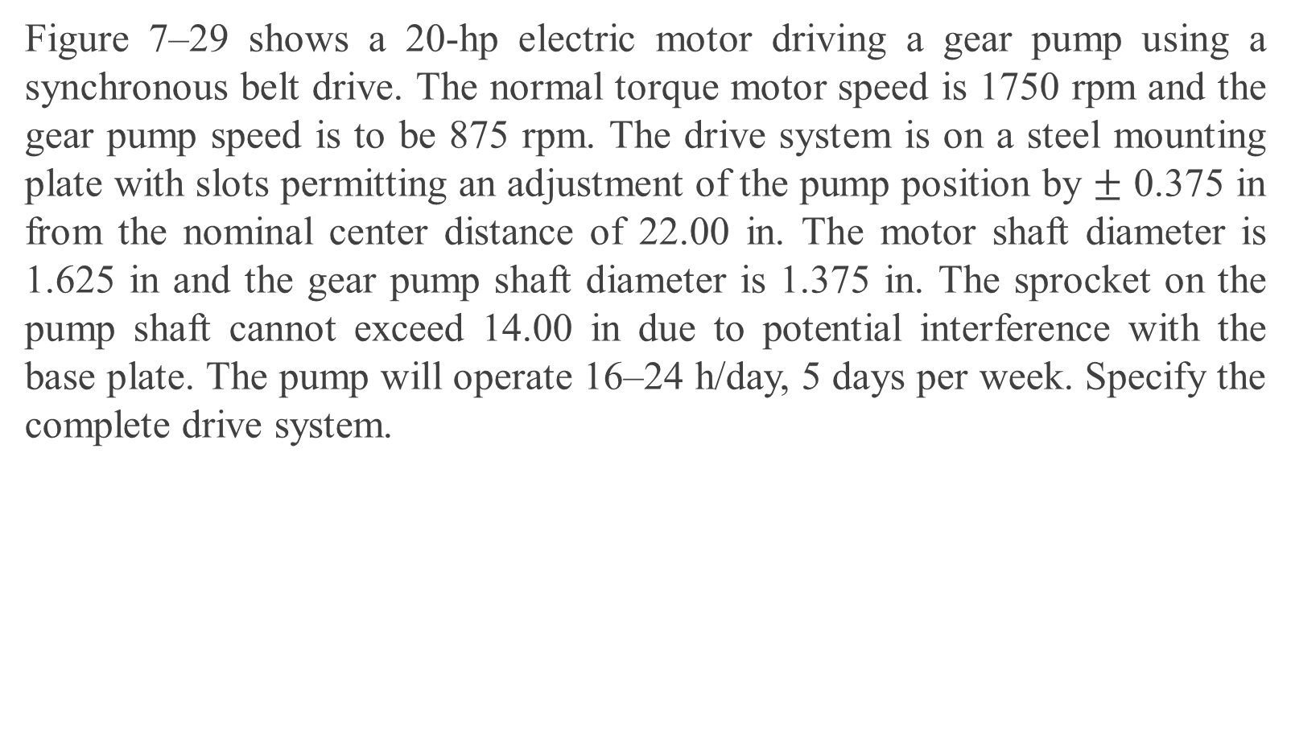
Example Problem
Figure 7–29 shows a 20-hp electric motor driving a gear pump using a synchronous belt drive. The normal torque motor speed is 1750 rpm and the gear pump speed is to be 875 rpm. The drive system is on a steel mounting plate with slots permitting an adjustment of the pump position by $±$ 0.375 in from the nominal center distance of 22.00 in. The motor shaft diameter is 1.625 in and the gear pump shaft diameter is 1.375 in. The sprocket on the pump shaft cannot exceed 14.00 in due to potential interference with the base plate. The pump will operate 16–24 h/day, 5 days per week. Specify the complete drive system.

Slide 36
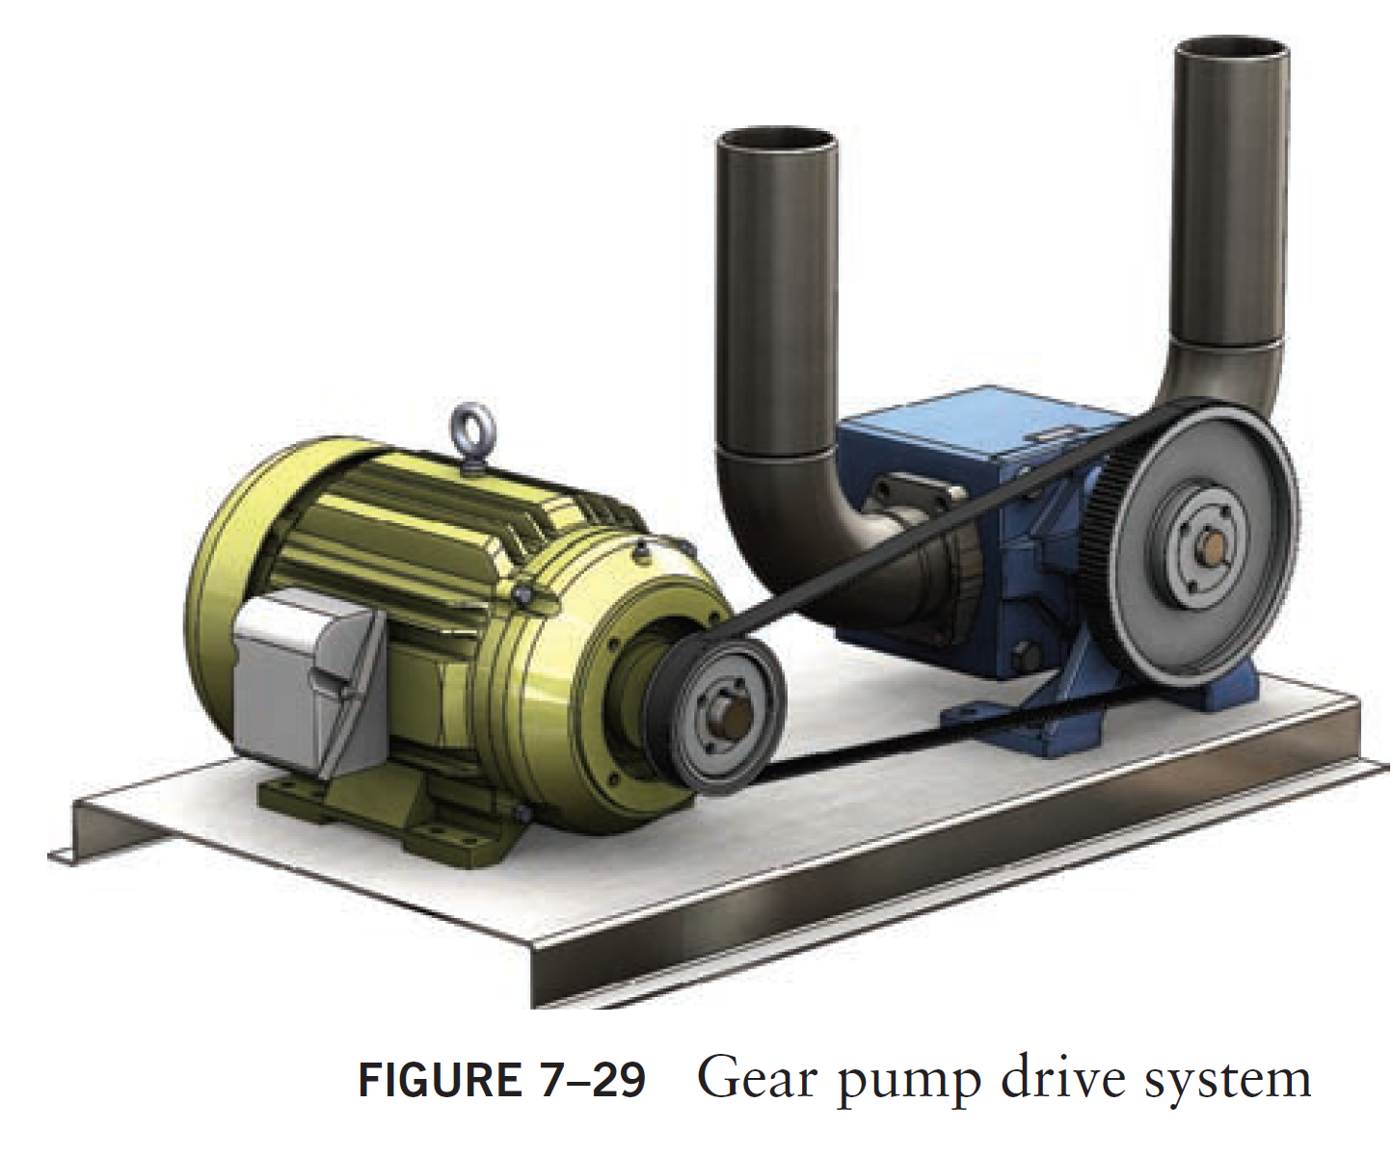
Sprocket Designations
Example Problem

Slide 37
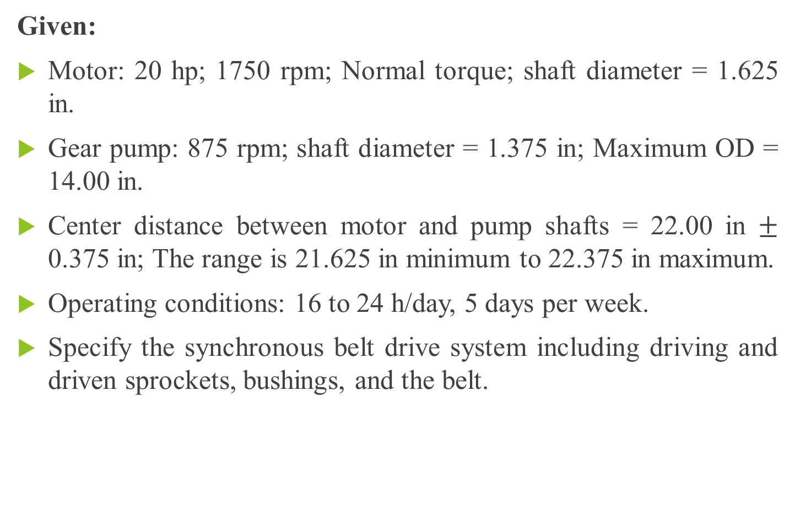
Example Problem
Given:
Motor: 20 hp; 1750 rpm; Normal torque; shaft diameter = 1.625 in.
Gear pump: 875 rpm; shaft diameter = 1.375 in; Maximum OD = 14.00 in.
Center distance between motor and pump shafts = 22.00 in $±$ 0.375 in; The range is 21.625 in minimum to 22.375 in maximum.
Operating conditions: 16 to 24 h/day, 5 days per week.
Specify the synchronous belt drive system including driving and driven sprockets, bushings, and the belt.

Slide 38
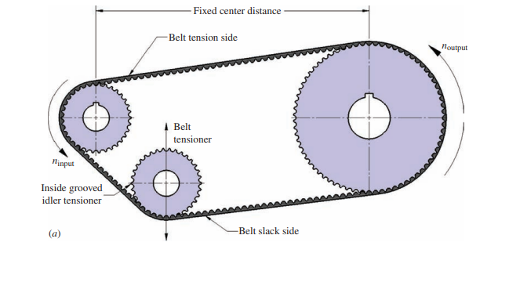
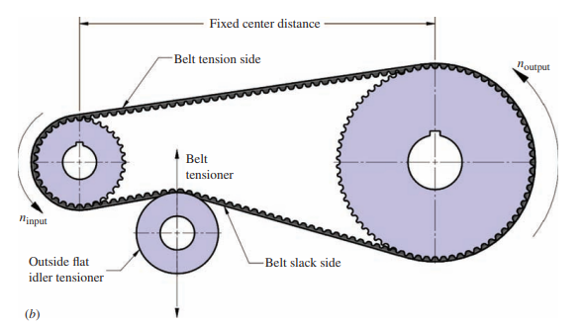
Alternate Configurations for Synchronous Belt Drives

Slide 39
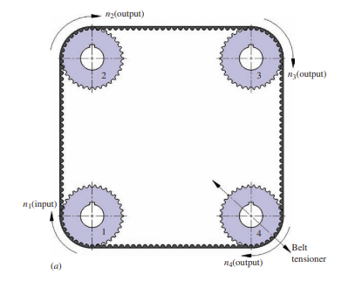
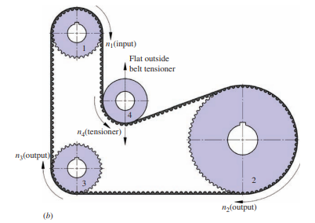
The tensioner may decrease the life of the belt and the belt manufacturer should be consulted.

Slide 40
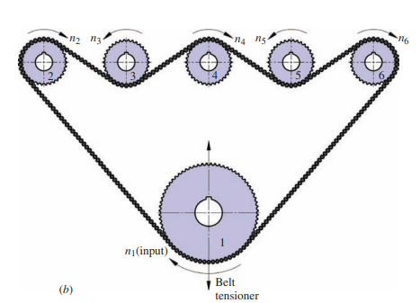
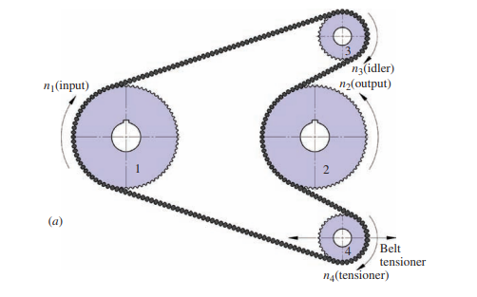
Twin Power Belts
Serpentine Belt drive configurations

Slide 41
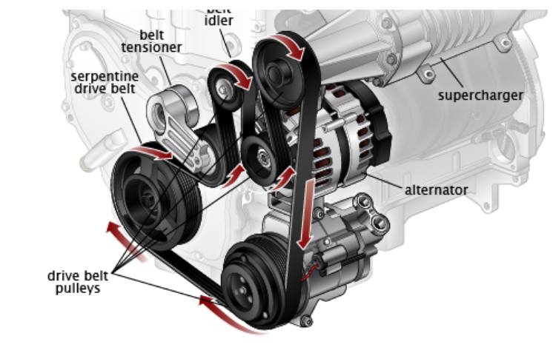
Do all cars have serpentine belts?
Most modern vehicles do have serpentine belts, but older models can have v-belts. The serpentine belt is a single, continuous belt that operates multiple devices in an engine including the alternator, air conditioner, water pump, and power steering pump. In engines that have v-belts.
Individual belts operate these components and the automobile can have up to four different belts.
The advantage of a serpentine belt is its efficiency.
Having a single belt increases fuel economy and available power.
The disadvantage of a serpentine belt is if it breaks several critical functions of the engine are lost and the engine will conk out leaving you stranded.

Slide 42
CHAIN DRIVES

Slide 43
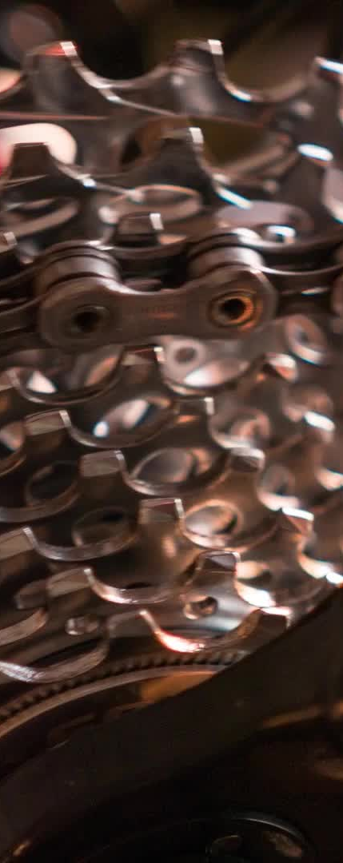
Chain Drives
When transmitting power between rotating shafts, the chain engages mating-toothed wheels, called sprockets.
The most common type of chain is the roller chain, in which the roller on each pin provides exceptionally low friction between the chain and the sprockets.

Slide 44
Roller Chain
Roller chain is classified by its pitch, the distance between corresponding parts of adjacent links.
U.S. Standard roller chain carries a size designation from 40 to 240.
For example, the no. 100 chain has a pitch of 10/8 or 1-1/4 in.
The average tensile strengths of the various chain sizes are also listed in Table 7–12.
ISO standards define several different chain types, data for three of which are listed in Table 7–13.

Slide 45
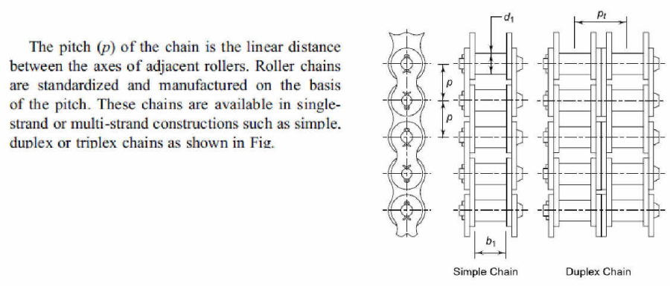
Roller Chain

Slide 46
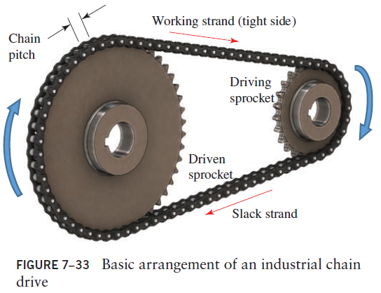
Chain Drives
A chain is a power transmission element made as a series of pin-connected links. The design provides for flexibility while enabling the chain to transmit large tensile forces.

Slide 47
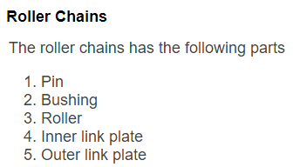
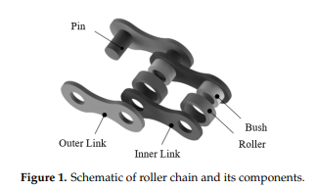

Slide 48
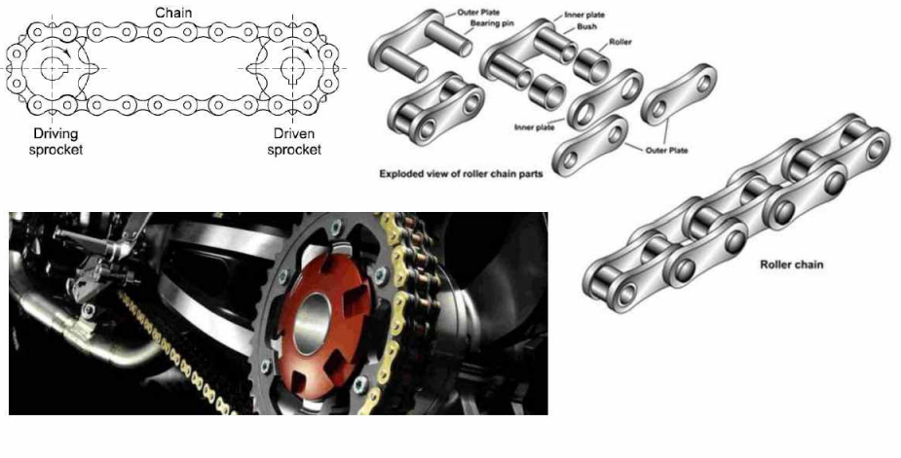

Slide 49
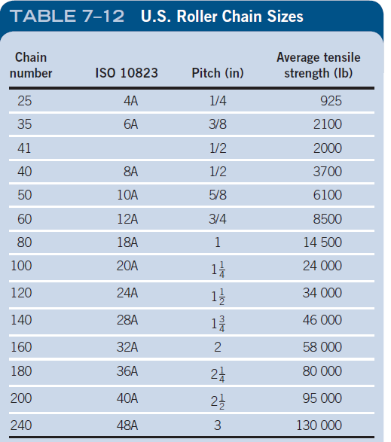
Roller Chains

Slide 50
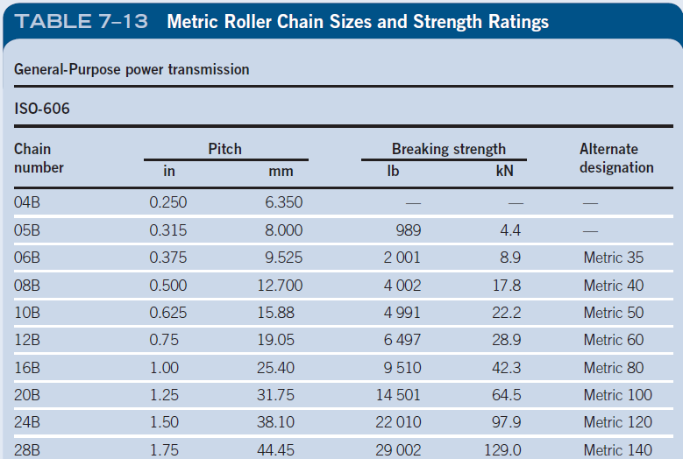
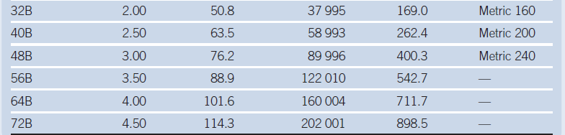
Synchronous Belt Drives

Slide 51
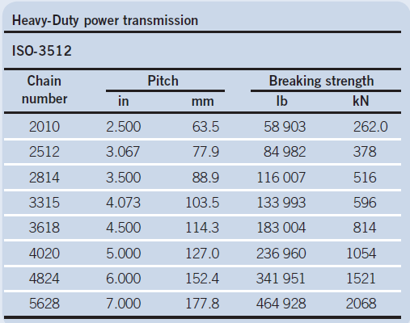
Metric Chain sizes for Heavy Power Transmission

Slide 52
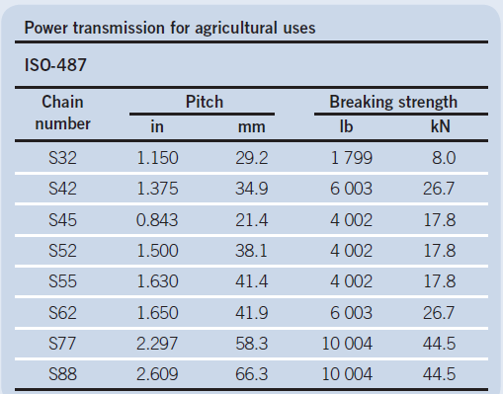
Metric Chain sizes for Agricultural uses

Slide 53

Roller Chain Shapes

Slide 54


Double Pitch Roller Chain has the same basic construction as Standard Roller Chain, but double pitch means the chain pitch is twice as long, has flat-shaped link plates, and longer attachments.

Slide 55



Slide 56



Slide 57


Slide 58
Design of Chain Drives
The rating of chain for its power transmission capacity considers three modes of failure:
fatigue of the link plates due to the repeated application of the tension in the tight side of the chain.
impact of the rollers as they engage the sprocket teeth.
galling between the pins of each link and the bushings on the pins
The ratings are based on empirical data with a smooth driver and a smooth load (service factor = 1.0) and with a rated life of approximately 15 000 h

Slide 59
Design of Chain Drives
FATIGUE
As the chain passes around the sprocket wheel, it is subjected to a tensile force, which varies from a max on the tight side to a min on the loose side.
The chain link is subjected to one complete cycle of fluctuating stresses during every revolution of the sprocket wheel which results in fatigue failure.
IMPACT
The engagement of the rollers with the teeth of the sprocket results in impact which leads to breakage of roller or bushing.
By increasing the number of teeth on the sprocket or reducing chain tension and speed we can reduce the magnitude of the impact force.
GALLING
Galling is a stick-slip phenomenon between the pin and the bushing
When the chain tension is high, welds are formed at the high spots of the contacting area.
Such microscopic weld immediately broke down due to the relative motion of the contacting surface, eventually leading to excessive wear even in the presence of the lubricant.

Slide 60


Slide 61
Chain Wear
Sometimes, the wear between the pin and bushing causes the chain to elongate (grow longer but not stretch) until the chain will not fit the sprockets correctly or will not maintain correct spacing or timing.
Chain wear elongation usually progresses through three stages as shown in Figure. First, there is a short period of rapid initial or run-in wear. In this first stage, high spots are worn off the pins and bushings, and minor misalignments are quickly worn away.
Second, there is a period of constant slow, or lubricated wear. In this second stage, the pins are seated properly in the bushings and the bearing areas are normally well-lubricated.
And finally, there is another period of rapid, or terminal wear. In this final stage, lubrication may have become ineffective or failed completely, or the hard case on pins and bushings may have worn through, or chain elongation on the sprocket may have caused loads on individual joints to increase dramatically.

Slide 62


Chain Wear
Chain elongation process

Slide 63

Lubrication effects on chain life
The majority of chain drives and conveyors will perform better and last longer when timely and adequate lubrication is provided. One rule-of-thumb is that proper lubrication can extend chain life by as much as 100 times
Rapid joint wear can cause early loss of timing in a conveyor. Lack of lubrication can increase friction and power consumption and cause a harmful temperature rise.

Slide 64
Design of Chain Drives
Tables 7–14 to 7–16 list the rated power for three sizes of standard chain: no. 40 (1/2 in), no. 60 (3/4 in), and no. 80 (1.00 in).
These are typical of the types of data available for all chain sizes in manufacturers’ catalogs and can be used for problems in this book.

Slide 65
Design of Chain Drives
The ratings are based on the speed of the smaller sprocket and an expected life of approximately 15 000 h.
For a given speed, the power capacity increases with the number of teeth on the sprocket.
For a given sprocket size (a given number of teeth), the power capacity increases with increasing speed up to a point; then it decreases.
Fatigue due to the tension in the chain governs at the low to moderate speeds; impact on the sprockets governs at the higher speeds.

Slide 66
Design of Chain Drives
The ratings are for a single strand of chain. Although multiple strands do increase the power capacity, they do not provide a direct multiple of the single-strand capacity.
Multiply the capacity in the tables by the following factors.
Two strands: Factor = 1.7
Three strands: Factor = 2.5
Four strands: Factor = 3.3
The chain manufacturer’s ratings are for a service factor of 1.0. Specify a service factor for a given application as shown in Table 7–16.

Slide 67
DESIGN GUIDELINES FOR CHAIN DRIVES
The minimum number of teeth in a sprocket should be 17 unless the drive is operating at a very low speed, under 100 rpm.
The maximum speed ratio should be 7.0, although higher ratios are feasible. Two or more stages of reduction can be used to achieve higher ratios.
The center distance between the sprocket axes should be approximately 30 to 50 pitches (30–50 times the pitch of the chain).

Slide 68
DESIGN GUIDELINES FOR CHAIN DRIVES
The larger sprocket should normally have no more than 120 teeth.
The preferred arrangement for a chain drive is with the centerline of the sprockets horizontal and with the tight side on top.
The chain length must be an integral multiple of the pitch, and an even number of pitches is recommended. The center distance should be made adjustable to accommodate the chain length and to take up for tolerances and wear.

Slide 69


DESIGN GUIDELINES FOR CHAIN DRIVES
➭ Chain Length in Pitches
➭
Center Distance in Pitches
The computed center distance assumes no sag in either the tight or the slack side of the chain, and thus it is a maximum.

Slide 70

DESIGN GUIDELINES FOR CHAIN DRIVES
The pitch diameter of a sprocket with N teeth for a chain with a pitch of p is:
➭ Pitch Diameter of Sprocket
The minimum sprocket diameter and therefore the minimum number of teeth in a sprocket are often limited by the size of the shaft on which it is mounted. Check the sprocket catalog.

Slide 71


DESIGN GUIDELINES FOR CHAIN DRIVES
The arc of contact,$θ_{1}$, often called the angle of wrap, of the chain on the smaller sprocket should be greater than 120°.
➭ Angle of Wrap Smaller Sprocket
For reference, the arc of contact, u2, on the larger sprocket is:
➭ Angle of Wrap Large Sprocket

Slide 72

Synchronous Belt Drives
Synchronous belts are constructed with ribs or teeth across the underside of the belt

Slide 73
Lubrication
It is essential that adequate lubrication be provided for chain drives.
There are numerous moving parts within the chain, along with the interaction between the chain and the sprocket teeth.
The designer must define the lubricant properties and the method of lubrication.

Slide 74
Lubrication
Lubricant Properties. Petroleum-based lubricating oil similar to engine oil is recommended.
Its viscosity must enable the oil to flow readily between chain surfaces that move relative to each other while providing adequate lubrication action.
Table 7–18 gives the recommended lubricants for different ambient temperatures.

Slide 75

Lubrication

Slide 76
Design of Chain Drives
The ratings are for a single strand of chain. Although multiple strands do increase the power capacity, they do not provide a direct multiple of the single-strand capacity.

Slide 77
Lubrication
Method of Lubrication. The American Chain Association recommends three different types of lubrication depending on the speed of operation and the power being transmitted.
See Tables 7–14 to 7–16 or manufacturers’ catalogs for recommendations.

Slide 78



Lubrication
Method of Lubrication.
Type A. Manual or drip lubrication: For manual lubrication, oil is applied copiously with a brush or a spout can, at least once every 8 hours of operation
Drip Lubrication: Usually 4-20 drops of oil per
minute. Excess oil should be caught in a drip pan.
Type B. Bath or disc lubrication: The chain cover provides a sump of oil into which the chain dips continuously. Alternatively, a disc or a slinger can be attached to one of the shafts to lift oil to a trough above the lower strand of chain.
Type C. Oil stream lubrication: An oil pump delivers a continuous stream of oil on the lower part of the chain.
The oil is pumped under pressure to nozzles that deliver a stream or spray onto the lower span of the chain from the inside of the loop. The oil spray should be distributed uniformly across the entire width of the chain.

Slide 79
Lubrication
Method of Lubrication
1) Type A
Manual or drip lubrication: For manual lubrication, oil is applied copiously with a brush, or a spout can, at least once every 8 hours of operation.
The amount of oil and the frequency of its application must be adequate to prevent the formation of a reddish-brown discoloration in the chain joints.
In drip lubrication, oil is dripped between the link plate or sidebar edges at a rate from four to 20 drops per minute, depending on speed.
The amount of oil and the frequency of its application must be adequate to prevent the formation of a reddish-brown discoloration in the chain joints.

Slide 80
Lubrication
2) Type B
Bath or disc lubrication: The chain cover provides a sump of oil into which the chain dips continuously.
Alternatively, a disc or a slinger can be attached to one of the shafts to lift oil to a trough above the lower strand of chain.
The chain should always run above the oil level in the casing.

Slide 81
Lubrication
3) Type C
Oil stream lubrication: An oil pump delivers a continuous stream of oil on the lower part of the chain.
the oil is pumped under pressure to nozzles that deliver a stream or spray onto the lower span of the chain from the inside of the loop
The oil spray should be distributed uniformly across the entire width of the chain.
The excess oil is collected in the bottom of the sump and returned to the pump via a reservoir.
An oil cooler may be used to keep oil temperature below the maximum limit.

Slide 82

Lubrication

Slide 83

Lubrication

Slide 84


Slide 85

Example Problem
Figure 7–37 shows a drive for a heavily loaded conveyor for use in the fields of a large commercial produce farm to take heavy containers of potatoes from the field onto trucks that will transport them to the processing plant. The conveyor is to be driven by a gasoline engine delivering 15.0 hp at a speed of 900 rpm. The conveyor pulley speed is to be 230 to 240 rpm. Design the chain drive.

Slide 86
Example Problem
Step 1: Specify a service factor and compute the design power. From Table 7–17.
Step 2. Compute the desired ratio.
Step 3. Refer to the tables for power capacity (Tables 7–14 to 7–16), and select the chain pitch.
Step 4. Compute the required number of teeth on the large sprocket.
Step 5. Compute the actual expected output speed
Step 6. Compute the pitch diameters of the sprockets.

Slide 87



Example Problem
Step 7. Specify the nominal center distance.
Step 8. Compute the required chain length in pitches.
Step 9. Specify an integral number of pitches for the chain length and compute the actual theoretical center distance.
Step 10. Compute the angle of wrap of the chain for each sprocket.
Summarize the design

Slide 88


Slide 89

Example
Create an alternate design for the conditions of Example Problem 7–5 to produce a smaller drive

Slide 90
References
Chapter 7, ‘Belt Drives, Chain Drives, and Wire Rope’
Machine Elements in Mechanical Design
By Robert L. Mott, Edward M. Vavrek, Jyhwen Wang, 6th edition

